Slide 1

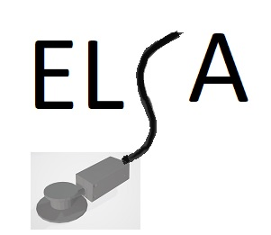
Electronic Stethoscope
Adapter
A simple disposable device that can be added to a conventional acoustic stethoscope in order to transform it into an "electronic stethoscope" that can be used even when wearing a full protective suit.

Slide 2
A device that keeps the medical personnel away from the possible contaminated surfaces is needed. For a developing country, where just preliminary examination is needed, this can make a difference in the protection of the medical personnel.
What problem does it solve ?

Slide 3

Inspiration
A team member read an article about the intubation of a Covid-19 patient in a Romanian hospital. The physician who performed the intubation did not have a video laryngoscope available nor could he use an ordinary stethoscope to verify the correctness of the intubation, for fear of contamination. Thus she realized that, in order to perform the auscultation of heart and lungs of a highly contagious patient, an ordinary stethoscope is not enough, the ear tips being impossible to use under the hood of the protective suit for safety reasons. That's why we thought that using audio headphones instead of ear tips can help medical staff perform their tasks safely.

Slide 4
Problems
Attaching the device mechanically and acoustically to a "normal" stethoscope
Transforming the sound into electronic signals that are amplified and sent to a headset worn by medical personnel over the protective suit
Maintaining the integrity of the protective gear of the medical personnel
Power consumption should be very low
The device should be electrically compatible with phones and headsets using 3.5mm audio jack and mechanically with a cheap range of disposable stethoscopes
The stethoscope itself can be a 3d printed one
The device should be inexpensive and easy to replicate

Slide 5
Solutions
Current design can be used with glasses as face protection mean. If headsets must be be worn over a face shield then is better to incorporate them into the protective suit and keep them in place by velcro type of attachment.
The device is electrically compatible with phones and headsets using 3.5mm audio jack and mechanically with a cheap range of disposable stethoscopes.
For attaching to different stethoscope necks sizes mechanical adapters can be provided.
Power supply is provided at low voltage 3v and by using easy to find 2032 cell batteries. Power consumption enables a minimum of 4h of continuous usage from one battery. In case of depletion the battery can be changed easily and there is a notification that battery is low.
Initial prototype transfers the sound by audio cable directly to the headsets but can also transfer it to the phone and from there can be captured, stored, analyzed and classified locally using a phone app or sent to cloud storage. Automatic Gain can be used suppressing high sound levels but for signal recording can be switched off thus both ways of working are maintained.
Furthermore, by using cloud based AI recognition of a cleaned sample, an initial automatic diagnosis can be provided in absence of sophisticated medical devices and highly qualified medical personnel.

Slide 6

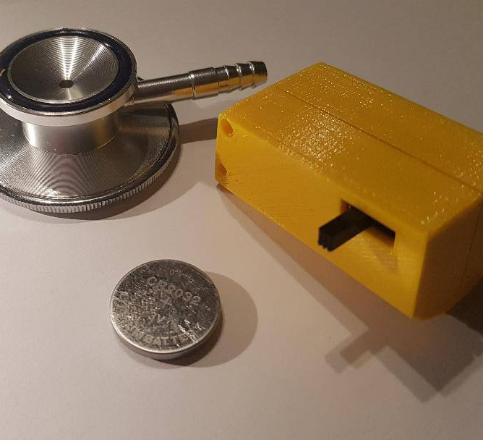
Differentiators
Low voltage and power consumption.
60DB gain in a 3.5mm audio jack headeset
Very cheap device and disposable biodegradable PLA case
Can target low income countries
Low frequency sounds can be transmitted for analysis

Slide 7
Description |  |  |  |  | Value | U/M
Hospitals in Romania on 31.03.2020 that treat COVID |  |  |  |  | 57 | unit
Number of beds in ATI |  |  |  |  | 2653 | pcs
Number of functional ventilators (approximate) |  |  |  |  | 1000 | buc
Active cases COVID (25.04.2020) minimum |  |  |  |  | 6000 | patients
Percentage of patients in ATI (assumption) |  |  |  |  | 15 | %
ATI cases (assumption) |  |  |  |  | 900 | patients
Number of active cases over a month (assumption) |  |  |  |  | 4000 | patients
Percentage of patients in ATI (assumption) |  |  |  |  | 15 | %
Cazuri in ATI (assumption) |  |  |  |  | 600 | patients
Average patients / hospital |  |  |  |  | 10.5 | patients
Number of devices / week / hospital (minimum) |  |  |  |  | 3 | disp
Number of devices / week / hospital (max) |  |  |  |  | 12 | disp
Total number of devices / month (minimum) |  |  |  |  | 684 | pcs
Total number of devices / month (maximum) |  |  |  |  | 2736 | pcs
We adopt the following option:
Devices for the first month |  |  |  |  | 400 | pcs
Devices for the second month |  |  |  |  | 800 | pcs
Devices for the third month |  |  |  |  | 800 | pcs
Total |  |  |  |  | 2000 | pcs
Business Case

Slide 8
Labor costs
Material costs
 |  | Time [H/day]
Design / testing |  | 4
Verification / Testing Technician |  | 8
Specialist Referent – Specialized Medic Referent – Doctor |  | 1
Assemblage technician |  | 8
Supply / Delivery |  | 4
Accounting / financial |  | 1
 |  | 26 hours/day
Packing |  | 0.2 | EUR
Plastic Injected case |  | 0.9 | EUR
Electronic assembly |  | 3.2 | EUR
Accessories (screws, rubber adapter, connector …) |  | 0.35 | EUR
Various unforeseen (defects, etc …) |  | 0.27 | EUR
 | Total | 4.92 | EUR

Slide 9

Revenue projection
 |  |  | Month
 |  | Total | 0 | 1 | 2 | 3 | 4 | 5 | 6
Monthly expense | [EUR] | 19,833 | 500 | 3,600 | 6,611 | 6,611 | 2,511
Investment expenses | [EUR] | 13,550 | 9,000 | 4,550
Materials | [EUR] | 9,840 | 3,000 | 1,000 | 4,000 | 1,840
Total | [EUR] | 43,223 | 12,500 | 9,150 | 10,611 | 8,451 | 2,511
Collection | [EUR] | 41,500 |  |  | 6,000 | 16,000 | 10,000 | 5,000 | 4,500
Price /piece |  |  |  |  | 20 | 20 | 20 | 20 | 30
No. units collected | [unit] |  |  |  | 300 | 800 | 500 | 250 | 150
Income-spend | [EUR] |  | -12500 | -9150 | -4611 | 7549 | 7489 | 5000 | 4500
Funding required | [EUR] |  | 12500 | 21650 | 26261 | 18712 | 11223 | 6223 | 1723
The above calculation reached a price/unit of 28.92 EUR for the first month and 19.96 for the following months.
The estimated market price for this device to be acceptable should be a maximum of EUR 20 which leads to the need to have an infusion of funds in order to sustain the urgent production activity in the first months.

Slide 10
Regulatory Considerations
Note: the estimated homologation costs for this device are between 4000 and 6000 EUR and the duration time is higher than 4 months.
The approval is provided by an authorized European body - this duration would lead to the exit from the initially proposed time interval.
The quick solution for use in Romania would be the approval by the Research Agency for Military Technique and Technologies - this process can be done only in the emergency period - for the devices now used in hospitals.
A certain European type-approval process is required if this medical device is to be used in the future in EU, after the emergency period.

Slide 11
Commercialization Strategy
The presented prototype can be built by a person with parts that are available on the market at a more than reasonable cost price.
However, the current situation creates the need to provide in a short time a larger number of devices which leads to the need of simplification of connections for a shorter assembly time.
For this reason the development plan is designed for another electronic board, than the one used in the presented prototype that was adapted, optimized to closely fill the requirements.
The presented prototype device is designed to be used now, in the Covid-19 crisis, and meets the specific requirements of this period.
For these reasons, the strategy was designed only to cover this short period.
The future solutions we intend to address require longer design and testing time and do not allow the implementation approach used in the current situation.
"Better a living donkey than a dead lion"

Slide 12
Thank you!

Slide 13
Backup slides

Slide 14
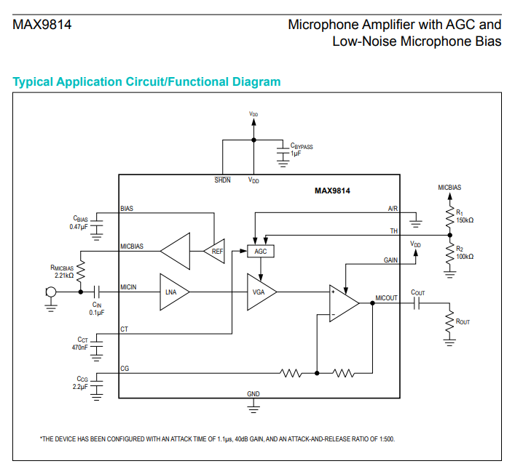
Electronic Design
The prototype device uses an Integrated circuit MAX9814 from Maxim Integrated
The MAX9814 is a low-cost, high-quality microphone amplifier with automatic gain control (AGC) and a low noise microphone bias. The MAX9814 consists of several distinct circuits: a low-noise preamplifier, a variable gain amplifier (VGA), an output amplifier, a microphone-biasvoltage generator, and AGC control circuitry. The output amplifier is the final stage in which a fixed gain of 8dB, 18dB, 20dB is programmed through a single trilevel logic input. With no compression from the AGC, the MAX9814 is capable of providing 40dB, 50dB, or 60dB gain. [https://datasheets.maximintegrated.com/en/ds/MAX9814.pdf ]

Slide 15
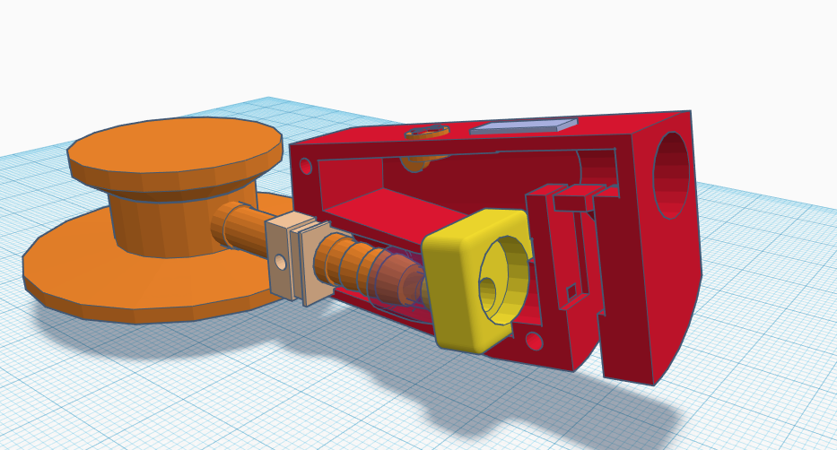
Mechanical Design

